Slide 1
Question Type Recognition for Natural Language Inputs
- Aishwarya Soni

Slide 2
What is NLP?
Natural Language processing is a way for computers to analyze, understand, and derive meaning from human language in a smart and useful way
By utilizing NLP, developers can organize and structure knowledge to perform tasks such as automatic summarization, translation, named entity recognition, question type recognition, sentiment analysis, and speech recognition

Slide 3
Problem Statement
The main task is that, given a question, we need to map it accurately to one of the k semantic classes
Example, “Who was the first woman killed in the Vietnam War?”
The above target of this question is a human, thereby reducing the space of possible answers significantly

Slide 4
Why Recognizing Question Types?
An important step in question answering (QA) and other dialog systems is to classify the question to the anticipated type of the answer
For example, the question of “Who discovered x-rays” should be classified into the type of human (individual)
This information would narrow down the search space to identify the correct answer string
This information can suggest different strategies to search and verify a candidate answer

Slide 5
Related Work
Rule based approach
It uses various types of interrogative words and word combinations with different kind of features extracted by experts
Example, classical logic rules, fuzzy rules, threshold rules and prototype based rule.
Performance issues on new dataset, hence no scaling up.

Slide 6
Supervised learning
Perform the classification by extracting some features from questions, train a classifier and predicting the class label using the trained classifier.
Unsupervised learning
K means clustering
Identify questions in the corpus that are similar and related to a question and group/cluster them as per their “relatedness” to the question
Use structure and lexical information to cluster questions as per their relatedness with the original question

Slide 7
Proposed Work
Implement a model using supervised learning method
Proposed algorithms:
SVM
Naïve Bayes
Decision Trees

Slide 8
Proposed Workflow
Question
corpus
Preprocess
Tokenize
Feature Extraction
Classifier
Question Type

Slide 9
Pre-processing-
Remove junk except for a-Z and A-Z
Change each character to lower case
Remove stop words
Feature extraction-
Words, part-of-speech (POS) tags, named entities, head chunks and semantically related words to be used as features
For semantically related words, a predefined list has been provided which has group of related words
Pos tags are extracted using a nltk pos_tag() function
To identify the question type pretrained question type classifier will be used

Slide 10

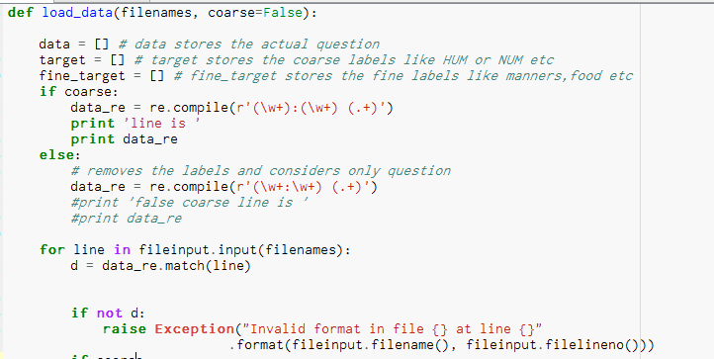
Loading data
After loading data, it is split using a regex into labels, fine labels and actual question

Slide 11
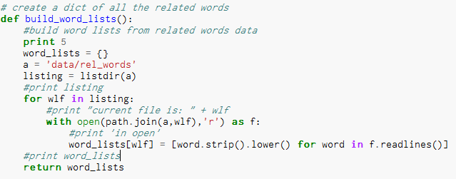
Preprocessing
Change each character to lower case

Slide 12
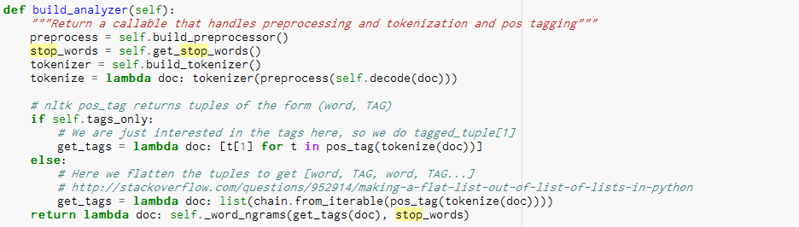
Remove stop words has been done in the estimator parameter

Slide 13
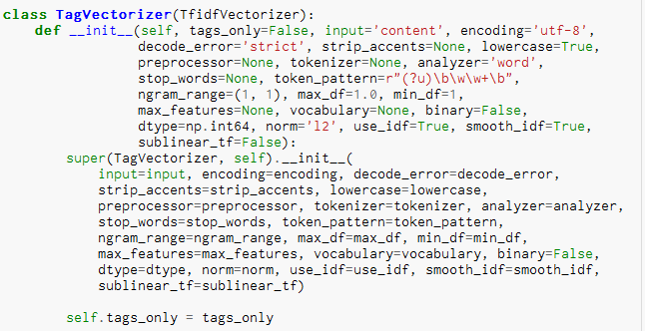
Feature Extraction
Extracting POS tags

Slide 14
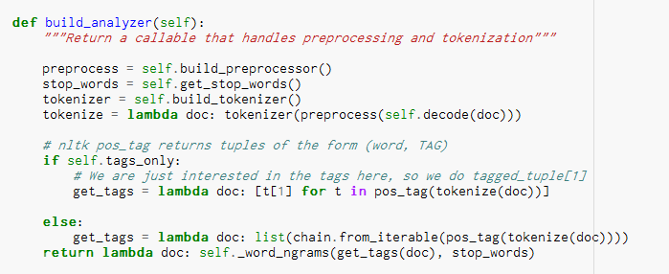
Feature Extraction
Extracting POS tags

Slide 15
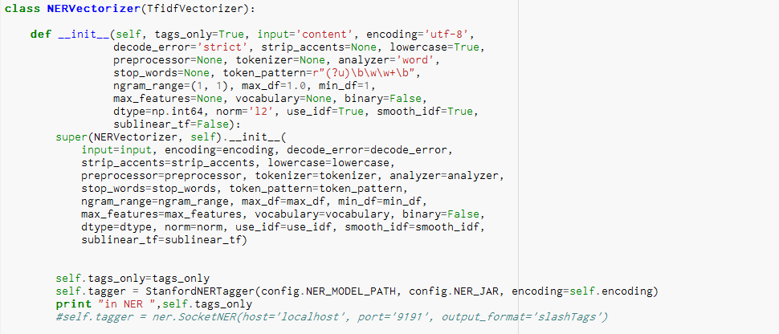
Feature Extraction
NER tagging

Slide 16
Feature Extraction
NER tagging

Slide 17
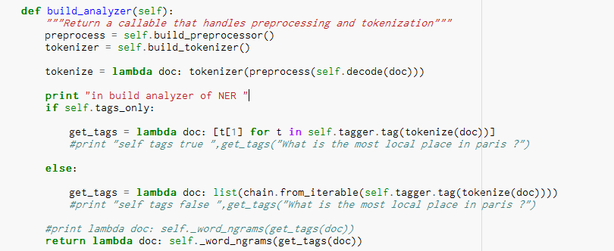
Feature Extraction
NER tagging

Slide 18
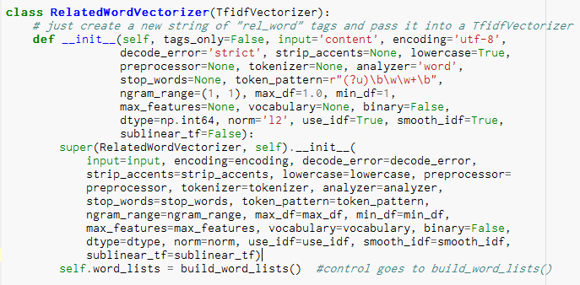
Feature Extraction
Related Word Vectorizer

Slide 19
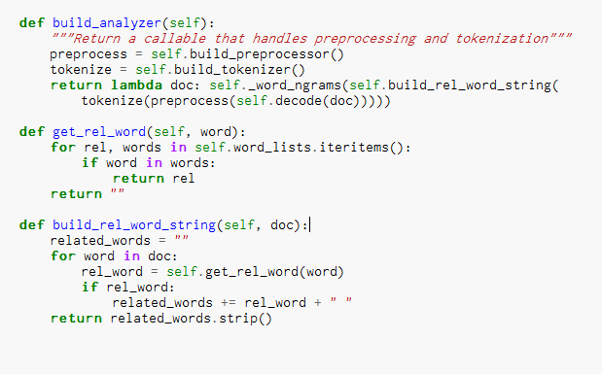
Feature Extraction
Related Word Vectorizer

Slide 20
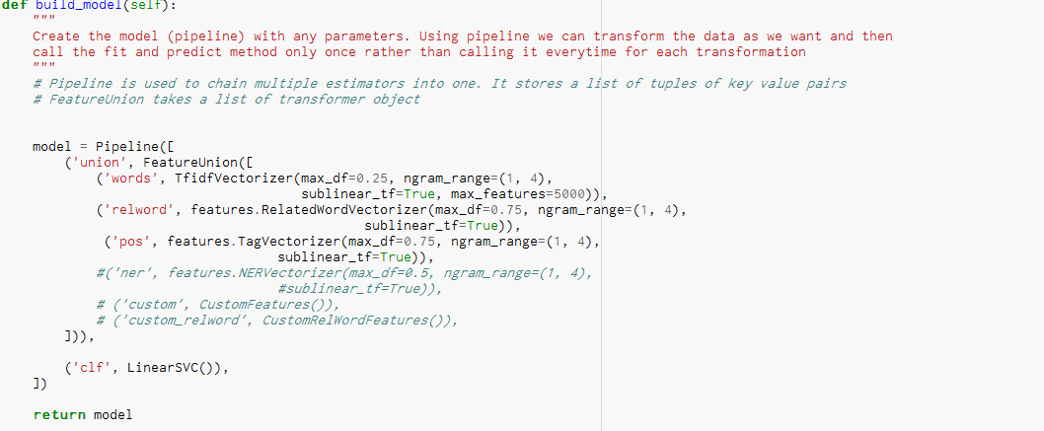
Creating Pipeline
TagVectorizer, NERVectorizer, RelatedWordVectorizer has been used as estimators which is then given to a pipeline

Slide 21
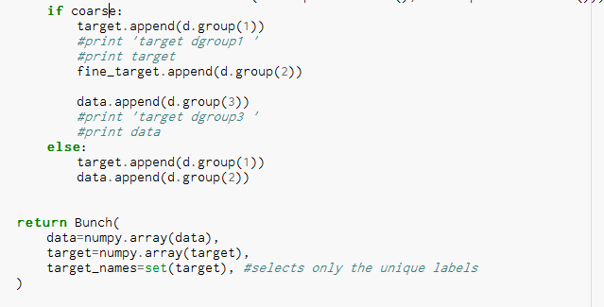
Coarse or Fine Classification
We can pass it as a parameter if we want coarse level filtering or fine level as an argument when we load the data
Processing is done accordingly

Slide 22
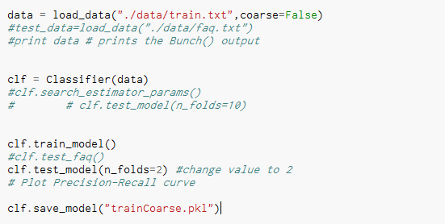
Train and Testing Model
Training our model

Slide 23
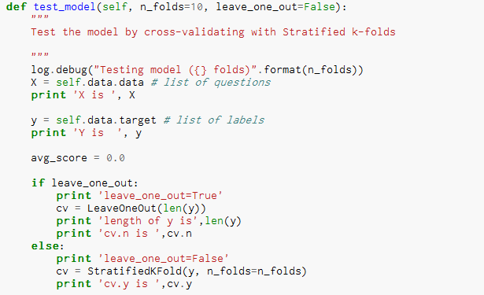
For testing, stratified k-folds CV technique is used as it provides a good performance. The stratified cross-validation allows for randomization and makes sure that unbalanced datasets have some of both classes.

Slide 24
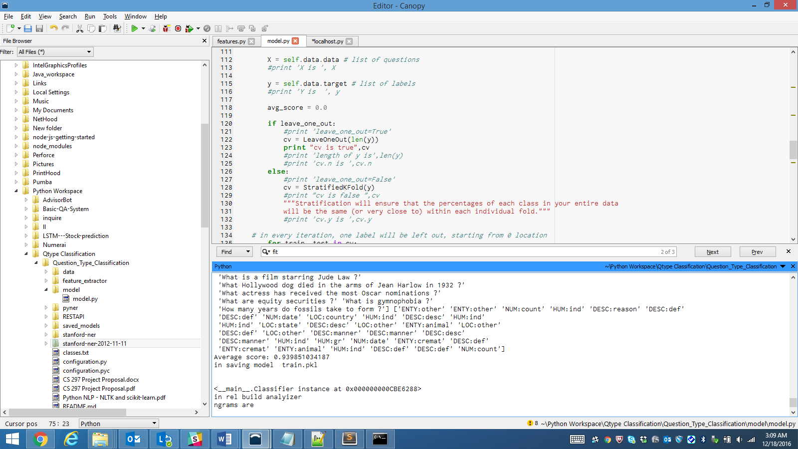
Results
Calculating the accuracy of the model
Average score: 93%

Slide 25
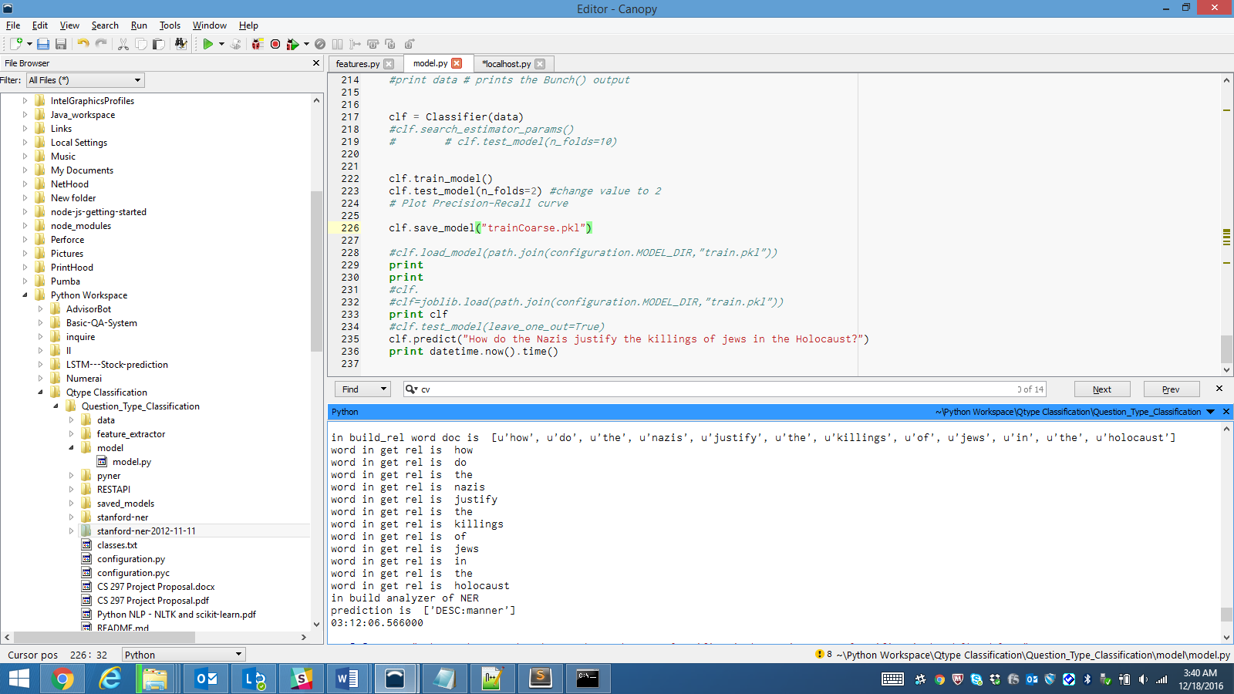
Test Prediction

Slide 26
Custom Middleware
Initially we used wit.ai to identify the intents
Here our model is predicting the intent
Create a custom middleware to communicate to our python code

Slide 27
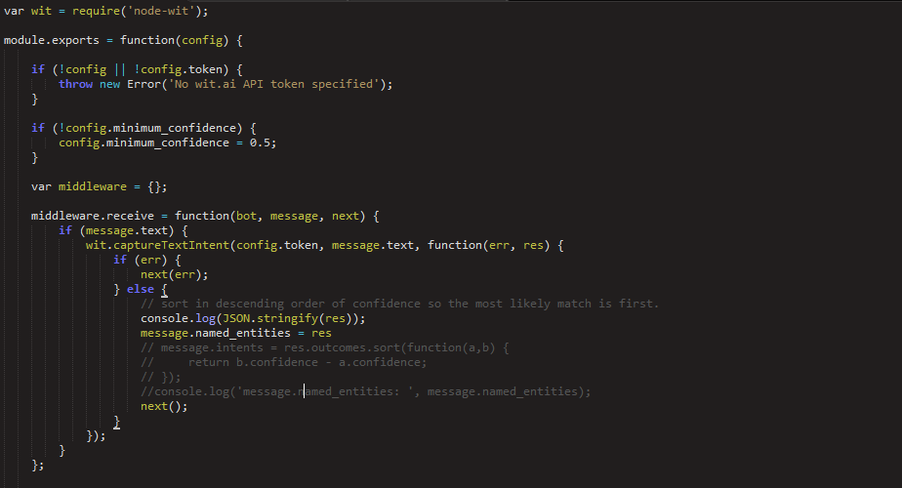
Middleware Implementation
Capture the intent

Slide 28
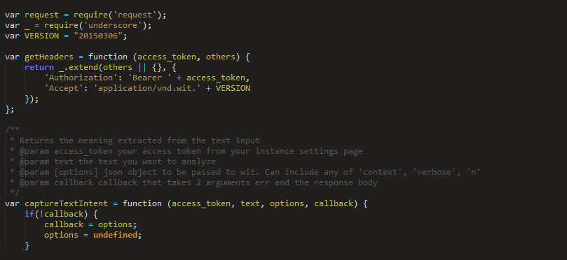
Middleware Implementation

Slide 29
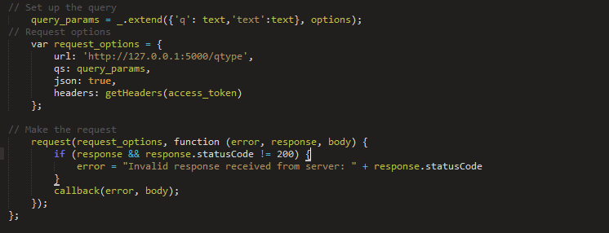
Middleware Implementation
URL is the end-point for the REST API

Slide 30
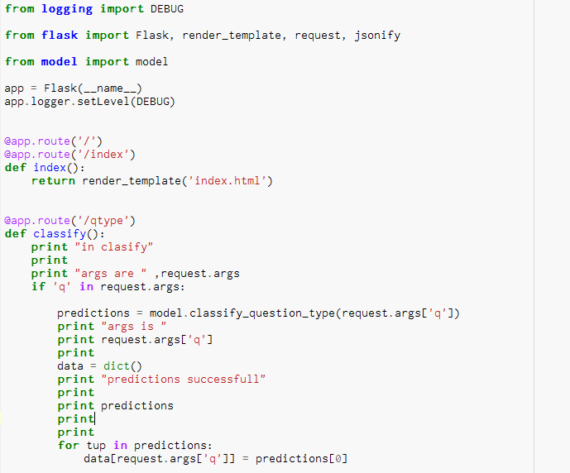
REST API Using Flask
Use python flask to convert our code as rest service

Slide 31
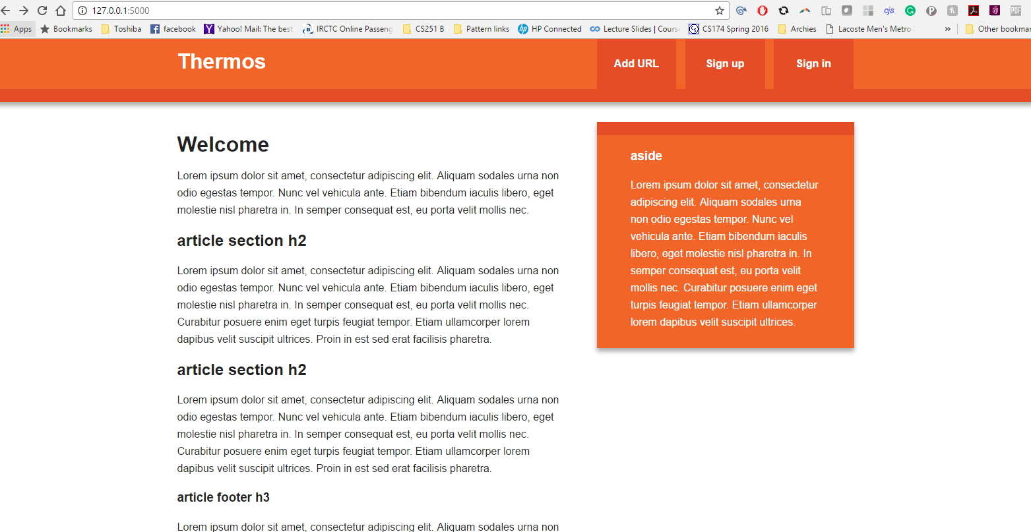
REST API Using Flask
Index.html

Slide 32
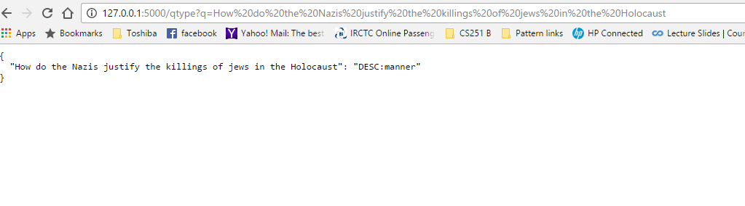
REST API Using Flask
Out of the REST service for a particular question

Slide 33
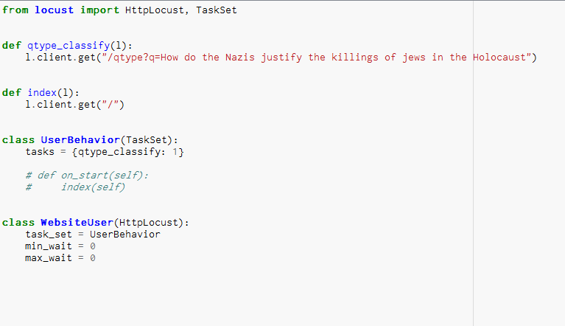
Load Testing
Aim is to test the load handling ability and to make it scalable

Slide 34
Load Testing
Specify the host address on which we have to perform load testing

Slide 35
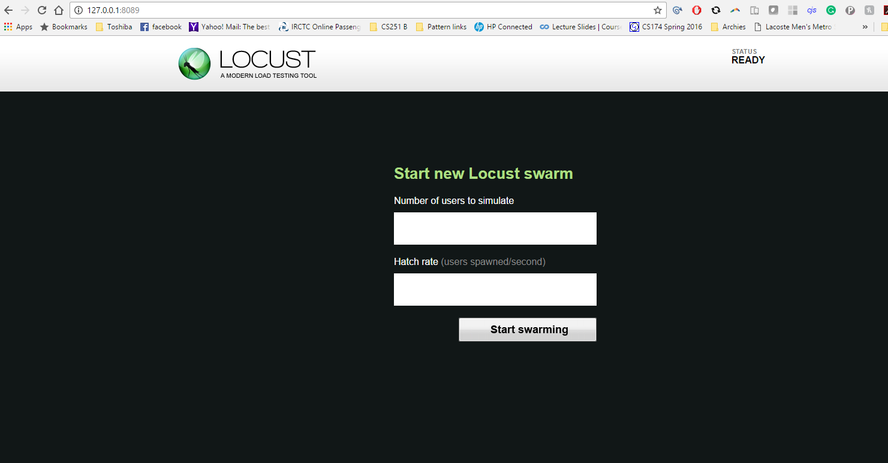
Attack Specification

Slide 36
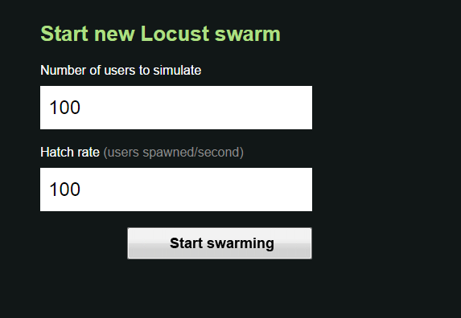
Attack Specification

Slide 37
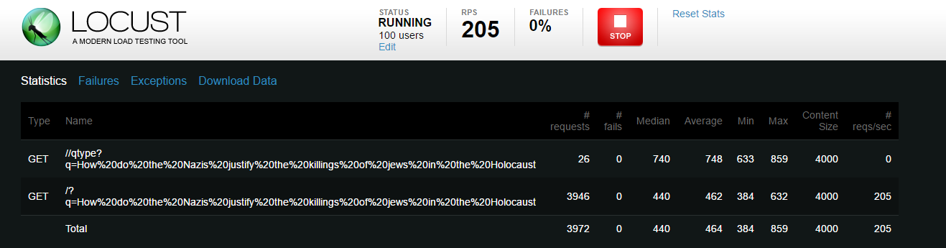
Load Testing Results

Slide 38
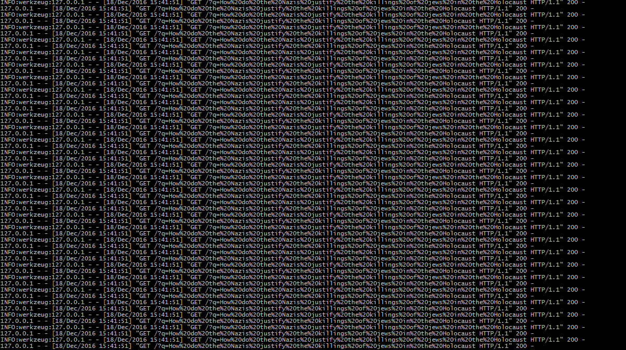
Affects of Load Testing on the Rest API

Slide 39

Demo

Slide 40
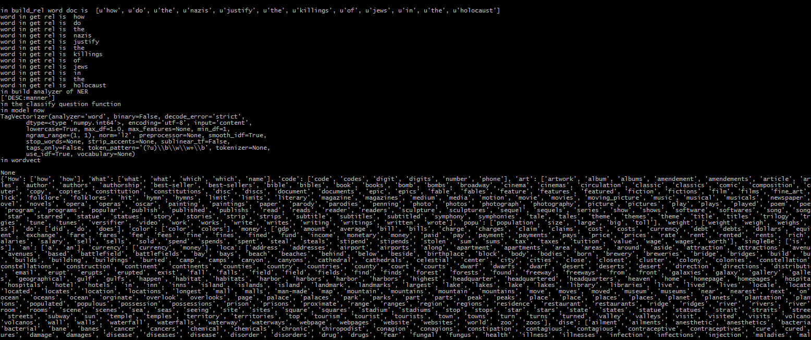
Demo

Slide 41
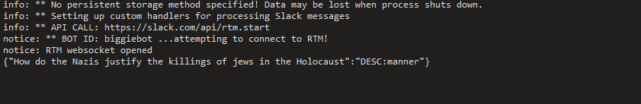
Demo

Slide 42

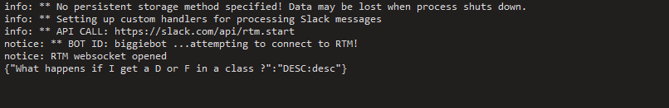
Demo

Slide 43
Evaluation
Comparing the results with the results obtained by the Text Retrieval Conference (TREC) QA model (http://trec.nist.gov/)
The focus of the TREC QA track is to build a fully automatic open-domain question answering system, which can answer factual questions based on very large document sets

Slide 44
Compare results with previous research papers based upon,
Accuracy
Precision
Recall
Check the results with other algorithms used and identify the best performing algorithm among them

Slide 45
Future Work
Improve the baseline by using tuning algorithm parameters
Use some big data tools for scaling the model to very large inputs
Improve the load balancing capability

